Slide 1


http://www.comp.nus.edu.sg/~cs1010/
WEEK 1
Class Activities

Slide 2
Week 1: Getting Started
Welcome and Admin Matters
Unit 1: Computing Fundamentals
Unit 2: Algorithmic Problem Solving
Things-To-Do
Announcements

Slide 3
Unit 1: Computing Fundamentals
We will go through the document “Getting Started with UNIX and CodeCrunch” (http://www.comp.nus.edu.sg/~cs1010/labs/2015s1/intro_lab/gettingStarted.html)
Objectives: To learn basic UNIX commands, the edit-compile-execute process, and the software use (vim for editing, gcc for compiling)
We will do CodeCrunch next week.

Slide 4
Unit 2: Algorithmic Problem Solving
We will go through some tasks on problem-solving.
You are to discuss and write the algorithms in pseudo-code.

Slide 5
Task 1: Area of a Circle (1/2)
What is the data?
Side of square = 2a
What is the unknown?
Area of circle, C
2a
What is the condition? That is, if what is known, then what can be computed?
If radius r is known, C can be computed.
What would be the next question?
How to obtain r ?

Slide 6
Task 1: Area of a Circle (2/2)
Pythagoras’ theorem: r² = 2 * a²
Area of circle C = π * r² = π * 2 * a²
a
r
a

Slide 7
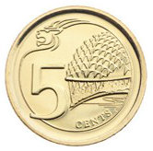

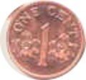
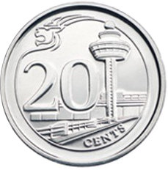
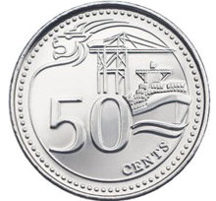
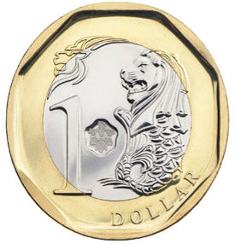
Task 2: Coin Change
Given these coin denominations: 1¢, 5¢, 10¢, 20¢, 50¢, and $1, find the smallest number of coins needed for a given amount. You do not need to list out what coins are used.
Example 1: For 375 cents, 6 coins are needed.
Example 2: For 543 cents, 10 coins are needed.

Slide 8
Task 2: Coin Change – A Possible Algorithm
Enter amt
coins ← 0
coins ← coins + (amt / 100)
amt ← remainder of amt / 100
coins ← coins + (amt / 50)
amt ← remainder of amt / 50
coins ← coins + (amt / 20)
amt ← remainder of amt / 20
coins ← coins + (amt / 10)
amt ← remainder of amt / 10
coins = ← coins + (amt / 5)
amt ← remainder of amt / 5
coins ← coins + amt
Print coins
We call this the integer modulo (or modulus) operation. It’s very handy!
In C, the modulo operator is %.
Hence,
amt ← remainder of amt / 100
can be written as:
amt ← amt % 100
amt % 100
amt % 50
amt % 20
amt % 10
amt % 5

Slide 9
Task 3: Breaking Up An Integer
A common sub-task in many problems involves number manipulation
252040312
2
5
2
4
3
2
1
0
0
Example: Given a positive integer n, how do you sum up all its individual digits?
The answer for the above example is 19 (2 + 5 + 2 + 0 + 4 + 0 + 3 + 1 + 2)

Slide 10
Algorithm Before Coding
The earlier examples show that we can discuss problems and their solutions (algorithms) without writing out the codes.
A sample program development process:
Understanding the problem (if in doubt, ask questions!): 5 minutes
Writing the algorithm: 30 minutes
Testing the algorithm: 20 minutes
Writing the program: 20 minutes
Testing and debugging the program: 30 minutes to 3 hours or more
For more complex problems, time spent in thinking about the algorithm could far exceed time spent in writing the program.
The more time you invest in writing a good algorithm, the more time you will save in debugging your program.

Slide 11

Things-To-Do
Read the CS1010 Student Handbook
Continue to practise the UNIX commands and vim on your own
Very important as you will need them in your practical exams
Revise Chapter 1 Programming Fundamentals
Preparation for next week:
Read Chapter 2 Variables, Arithmetic Expressions and Input/Output
Read Chapter 3 Lessons 3.1 Math Library Functions and 3.2 Single Character Data

Slide 12

Announcements
Introductory workshop
If you think you still need extra help on UNIX and vim after attending today’s sectional session and trying them out yourselves
Check out the IVLE forum on the dates and times and how to sign up

Slide 13
End of File

